Slide 1
Soccer Robot Localization Based on Sensor Fusion from Odometry and Omnivision
Muhammad Azhar Ismail, Djoko Purwanto, Achmad Arifin
Department of Electrical Engginering
Institut Teknologi Sepuluh Nopember
Surabaya, Indonesia

Slide 2

Outline
01
02
03
Introduction
Related Works
Method
04
05
Experiment Results and Discussion
Conclusion

Slide 3
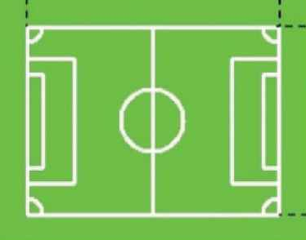
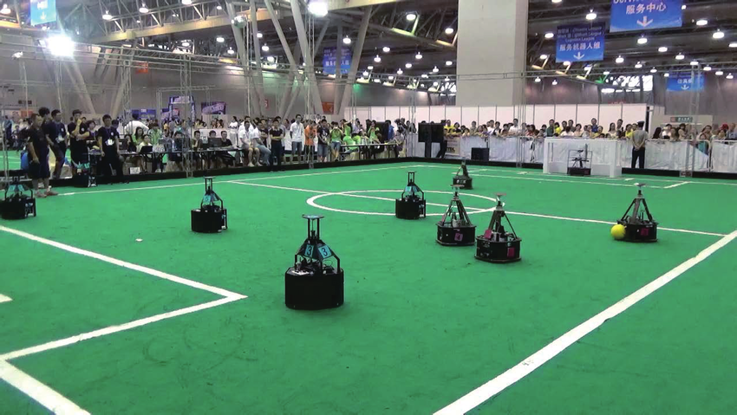
Introduction
Mobile Robot
RoboCup Middle Size League (MSL)
Self-localization

Slide 4
Related Works

Slide 5
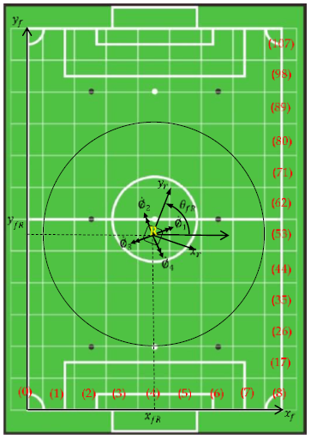
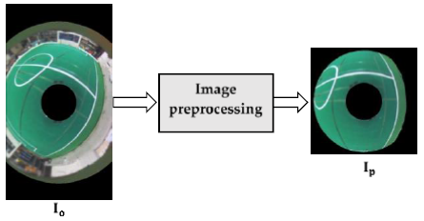
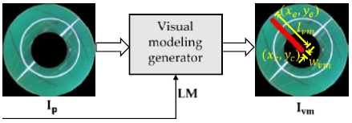
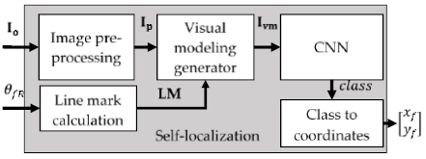
01
“CNN-Based Self Localization Using Visual Modelling of a Gyrocompass Line Mark and Omni-Vision Image for a Wheeled Soccer Robot Application”
R. Dikairono, S. Setiawardhana, D. Purwanto, dan T. Sardjono

Slide 6
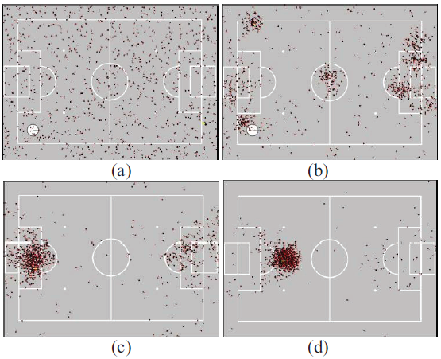
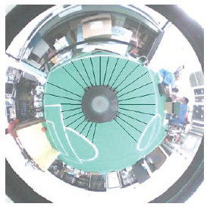
02
“Omnidirectional vision-based robot localization on soccer field by particle filter”
C.-Y. Chen, C.-Y. Ho, C.-C. Wong, dan H. Aoyama

Slide 7
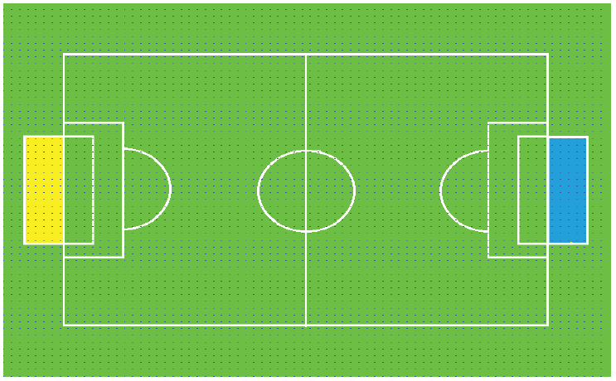
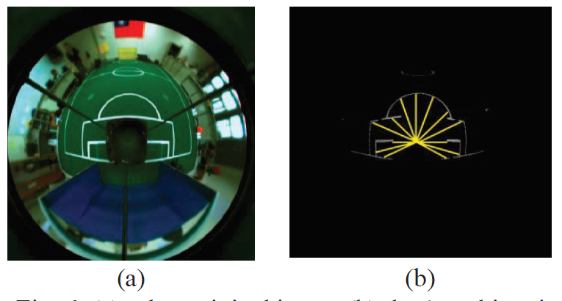
03
“Real time self-localization of omni-vision robot by pattern match system”
S.-Y. Chiang, X. Guo, dan H.-W. Hu

Slide 8
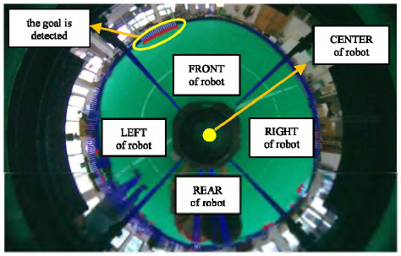
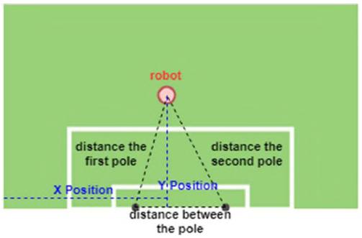
04
“Radial Search Lines Method for Estimating Soccer Robot Position Using an Omnidirectional Camera”
R. B. Hamarsudi, I. Kurnianto Wibowo, dan M. M. Bachtiar

Slide 9
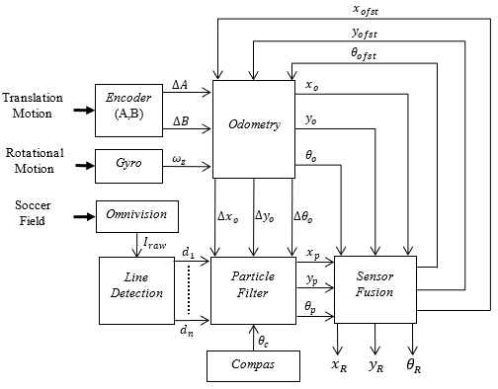
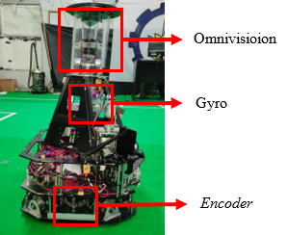


Method
$∆A$ : Encoder A displacement
$∆B$ : Encoder B displacement
$ω_{z}$ : Angular velocity z-axis
$d_{1−n}$ : White line distance data
$θ_{c}$ : Compas angel
$I_{raw}$ : Omnivision raw image
${[∆x}_{o} ∆y_{o} ∆θ_{o}]$ : Odometry displacement
${[x}_{o} y_{o} θ_{o}]$ : Odometry location
${[x}_{p} y_{p} θ_{p}]$ : Particle filter location
${[x}_{ofst} y_{ofst} θ_{ofst}]$ : Offset data for odometry
${[x}_{R} y_{R} θ_{R}]$ : Robot location
Overall System
Soccer Robot

Slide 10
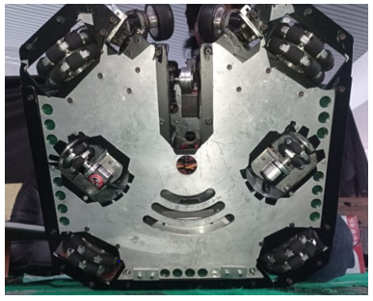
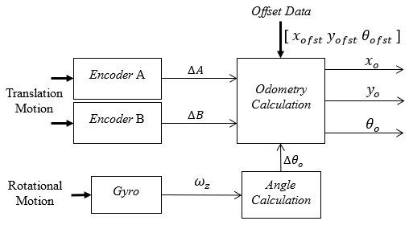
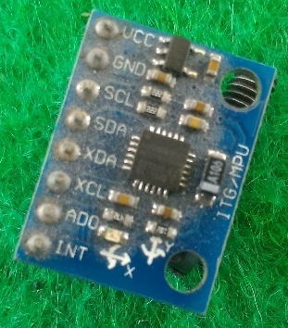
Odometry System
2 Optical Encoder
Gyroscope Sensor MPU6050

Slide 11
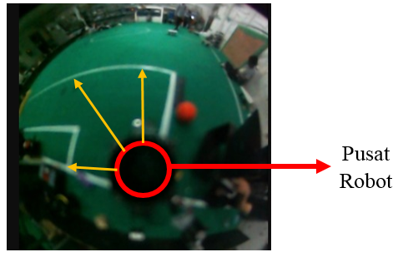
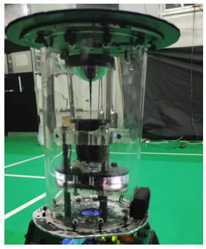
Omnivision
Omnivision Camera
360° Mirror
Camera Lens
Robot Center
Omnivision Raw Image
Digital Camera

Slide 12
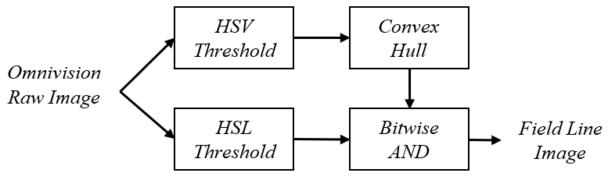
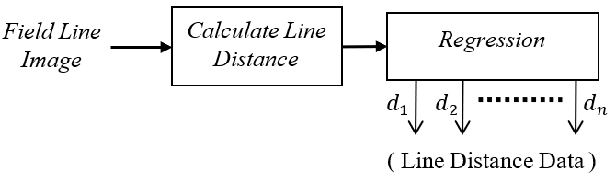
Line Detection System
Preprocessing Omnivision Raw Image
Field Line Distance Measurement

Slide 13
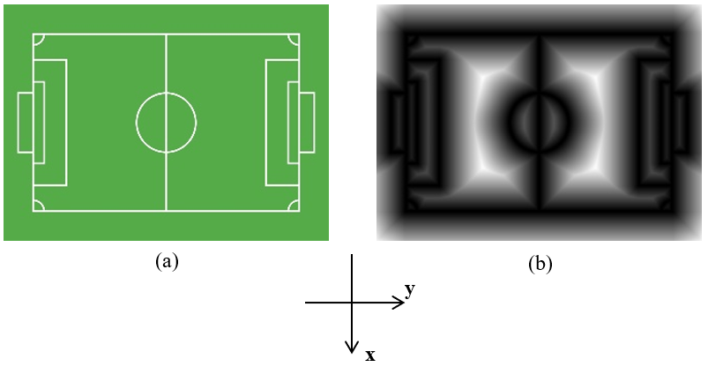
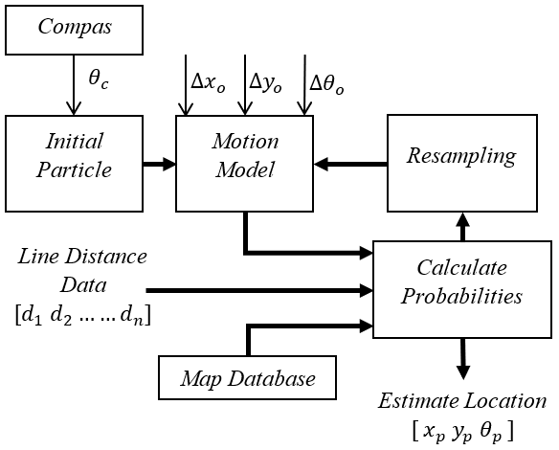
Particle Filter SysTem
Soccer Field Map and Field Line Error Distribution Map
Particle Filter Localization Process

Slide 14
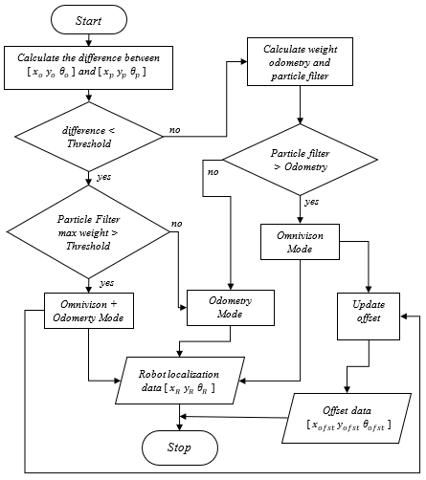
Sensor Fusion System
Sensor Fusion Algorithm
Determining Factor of Sensor Fusion:
Difference estimate location from odometry dan particle filter system
Maximum particle weight
Number of detected line distance data

Slide 15
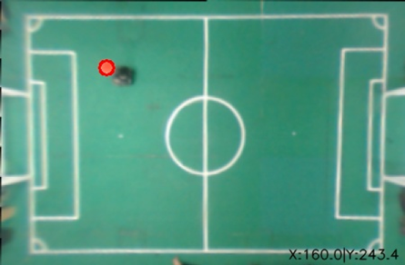
Experiment Results and Discussion
Soccer Robot Testing Field
The test was carried out on a soccer field with size 9m×6m to test the line detection ability and approximate location of the system that has been designed

Slide 16
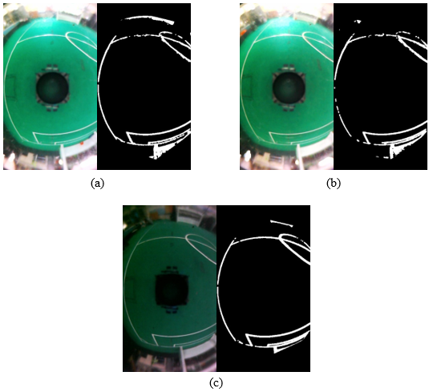
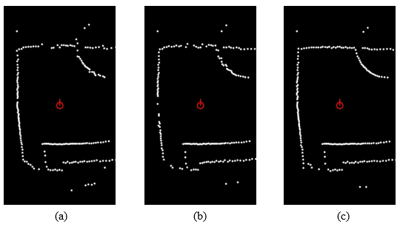
Line Detection Results
Detection Results
Regression Results

Slide 17
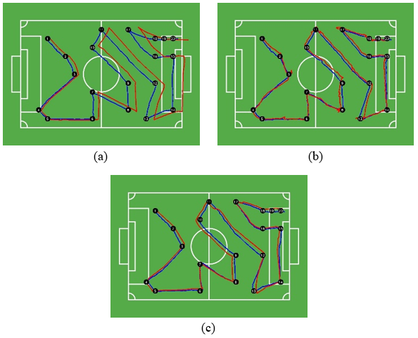
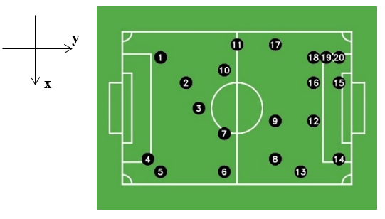
Robot Global Localization Results
20 Coordinates for Localization Test
Odometry (a), Particle Filter (b), Sensor Fusion (c)

Slide 18
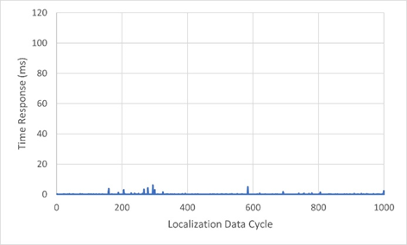
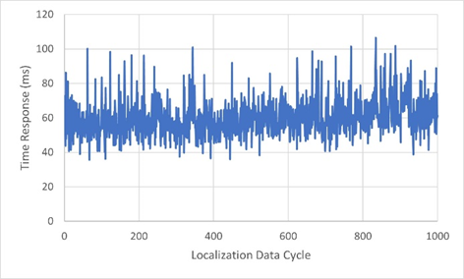
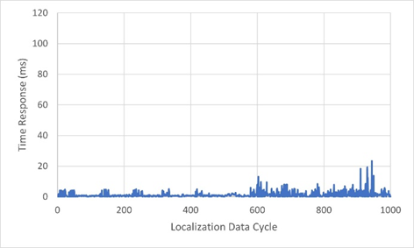
Time Response
Odometry
Particle Filter
Sensor Fusion

Slide 19
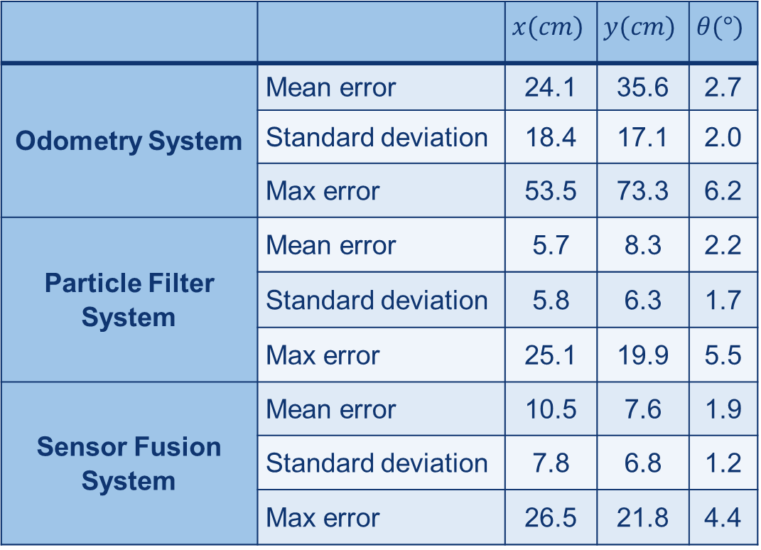
STATISTICS OF LOCALIZATION ERRORS
 |  | $$x(cm)$$ | $$y(cm)$$ | $$θ(°)$$
Odometry System | Mean error | 24.1 | 35.6 | 2.7
 | Standard deviation | 18.4 | 17.1 | 2.0
 | Max error | 53.5 | 73.3 | 6.2
Particle Filter System | Mean error | 5.7 | 8.3 | 2.2
 | Standard deviation | 5.8 | 6.3 | 1.7
 | Max error | 25.1 | 19.9 | 5.5
Sensor Fusion System | Mean error | 10.5 | 7.6 | 1.9
 | Standard deviation | 7.8 | 6.8 | 1.2
 | Max error | 26.5 | 21.8 | 4.4

Slide 20
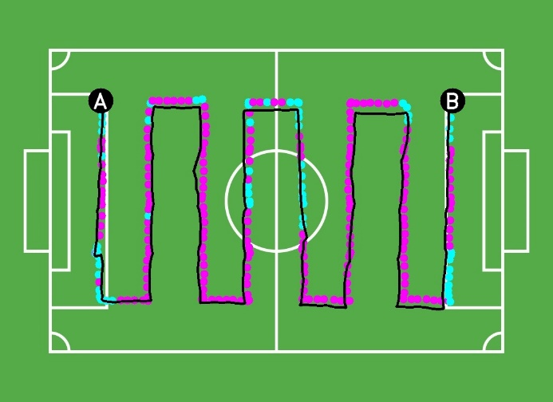
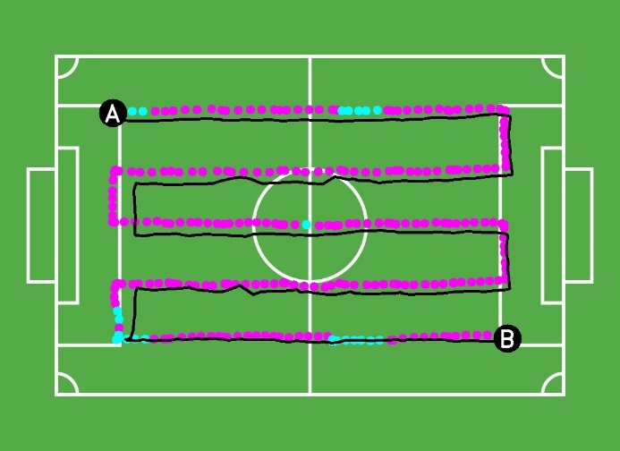
Sensor Fusion Results
(a)
(b)
Sensor Fusion Test 1 (a), Test 2 (b)

Slide 21
Cocnlusion
At soccer field with size 9m×6m, proposed method can provide accurate data with error x=10.5±7.8cm, y=7.6±6.8cm, and θ=1.9±1.2° with time response 1.6 ms.
Sensor Fusion can correct odometry error.
Sensor Fusion data are smoother and faster than particle filter

Slide 22
ACKNOWLEDGMENT
This research was supported by IRIS team from Sepuluh Nopember Institute of Technology (ITS). IRIS team is one of the ITS robotics teams that focuses on developing Middle Size League (MSL) wheeled soccer robot since 2017.

Slide 23

Thank you
azhar.206022@mhs.its.ac.id

